Slide 1
Technology Infrastructure
Lesson 5

Slide 2
Understanding how websites work
Duration : 2 Hours
Period : Week 1 Day 3

Slide 3
Learning Outcomes:
By the end of the lesson, students ,must be able to:
Define what a website is
Explain how websites work?
Differentiate website from web-based application.
Demonstrate an understanding of web protocols.
Demonstrate an understanding of Web Addresses
Web browsers and Web servers
HTML purpose and structure
Recap
Notes:
Tip: Add your own speaker notes here.

Slide 4
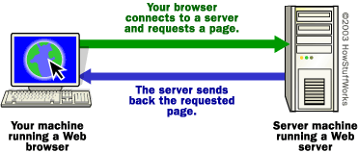
Web browsers and Web Servers
The content on the Web is available because the Web is a network of computers all over the world.
The interconnected devices on the Web use a communication standard known as http (hypertext transfer protocol).
Web servers are computers whose job is to respond to a browser’s request for a web page and deliver it through the internet
Notes:
Website- A collection of web pages which are grouped together and usually connected together in various ways. Often called a "web site" or simply a "site."web server A computer that hosts a website on the Internet.

Slide 5
Web Server
How is a page displayed
Client requests the page using server IP address (explained in the handout). Data is send to server in HTTP protocol using GET or POST methods. The request also consists of:Request-line, Requested URI (Uniform Resource Identifier), Request method and Content, User-Agent header and Message body.
Server responds by sending the page to the client IP address
Web client software formats and displays page for the user
Notes:
web serverA computer that hosts a website on the Internet.
A web server is server software, or hardware dedicated to running said software, that can satisfy World Wide Web client requests. A web server can, in general, contain one or more websites. A web server processes incoming network requests over HTTP and several other related protocols.
The primary function of a web server is to store, process and deliver web pages to clients. The communication between client and server takes place using the Hypertext Transfer Protocol (HTTP). Pages delivered are most frequently HTML documents, which may include images, style sheets and scripts in addition to the text content.

Slide 6





How does a web page gets displayed
You request a web document through your Web browser.
DNS Server
Client computing device
Checks domain name and finds address of web server
Web Host or Web Server
Sends requested document to your browser

Slide 7

Role of the Web Browser
HTML code is interpreted by a web browser. (a software application designed to retrieve and present content on the Web)
The web browser fetches a Web page from a server by a request. A standard http request includes a page address. For example: http://www.w3.org/standards/about.html
Common browsers:
Notes:
The web browser is installed on the client computer.
Web browser stores the cookies for different websites. The web browser act as an interface between the server and the client and displays a web document to the client.
The Web browser requests the server for the web documents and services.
search engine
A web service that helps you find other web pages, such as Google, Bing, Yahoo, or DuckDuckGo. Search engines are normally accessed through a web browser (e.g. you can perform search engine searches directly in the address bar of Firefox, Chrome, etc.) or through a web page (e.g. bing.com or duckduckgo.com).Let's look at a simple analogy — a public library. This is what you would generally do when visiting a library:
Find a search index and look for the title of the book you want.
Make a note of the catalog number of the book.
Go to the particular section containing the book, find the right catalog number, and get the book.

Slide 8
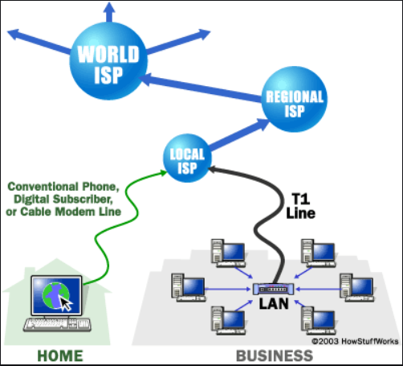
Understanding ISPs
ISP is an acronym for Internet Service Provider.
An ISP is a company that provides the connections and support to access the internet. ISPs can also provide emailing and web hosting.
Notes:
An ISP (Internet service provider) is a company that provides individuals and other companies access to the Internet and other related services such as Web site building and virtual hosting.
An ISP has the equipment and the telecommunication line access required to have a point-of-presence on the Internet for the geographic area served. The larger ISPs have their own high-speed leased lines so that they are less dependent on the telecommunication providers and can provide better service to their customers. Among the largest national and regional ISPs are AT&T WorldNet, IBM Global Network, MCI, Netcom, UUNet, and PSINet.

Slide 9
Who is your ISP? Discussion
197.221.14.53
Discuss your choice of X ISP over Y
To avoid every ISP connecting to each other directly?? Internet Exchange Points (IXP) provides common locations where they connect to each other and tis is called the backbone.
Dial-up vs ADSL vs Fibre: Which of the following do you use to connect to internet.
Notes:
Most providers offer the same types of internet services to customers, including:
internet access
email access
domain name registration
web hosting
co-location (or data centre services)
In providing services to their customers, many internet service providers (ISPs) introduce service level agreements against their offerings (Uptime

Slide 10
ISP Connection Options
Dial-Up
Cell modem
Digital Subscriber Line (DSL
Cable Modem
Leased lines
Satelite-
Notes:
Dial-Up-Slowest and least expensive
Cell modem Available through cellular telephone providers
Digital Subscriber Line (DSL)- high speed digital connection over regular telephone line
Cable Modem-High speed connection over the cable TV network.
Leased lines- available for most telephone companies
Satelite-

Slide 11
Domain Name Service (DNS)
DNS provides a way for hosts to use a name to request the IP address of a specific server. The common high level domains on the internet are the .com, .edu, .org, .net, .gov etc.
A DNS server running the DNS service contains a table that associates host names in a domain with corresponding IP addresses.
Notes:
DNS is also a globally distributed, scalable, reliable database
Comprised of three components
A “name space”
Servers making that name space available
Resolvers (clients) which query the servers about the name space
DNS as a lookup mechanism:
Users generally prefer names to numbers
Computers prefer numbers to names
DNS provides the mapping between the two
I have “x”, give me “y”
A domain name is the sequence of labels from a node to the root, separated by dots (“.”s), read left to right. The name space has a maximum depth of 127 levels
Domain names are limited to 255 characters in length
A node’s domain name identifies its position in the name space

Slide 12
Domain Name System
A hostname consists of the computer name followed by the domain name
www.uwc.ac.za is the domain name
A domain name is separated into two or more sections that specify the organization, and possibly a subset of an organization, of which the computer is a part
Two organizations can have a computer named the same thing because the domain name makes it clear which one is being referred to

Slide 13
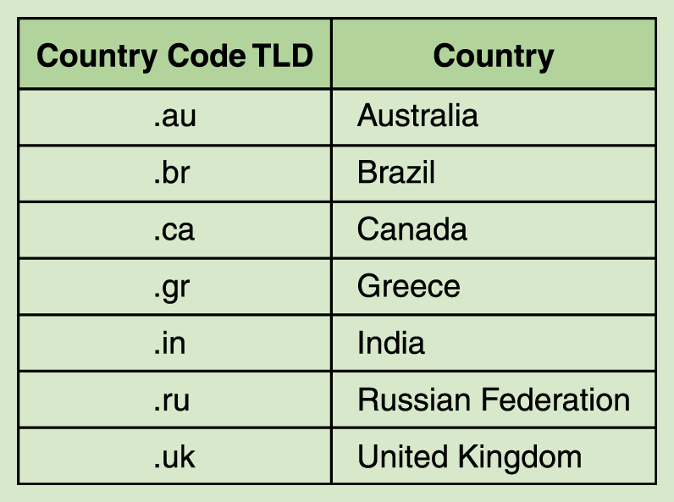
Domain Name System
Organizations based in countries other than the United States use a top-level domain that corresponds to their two-letter country codes
Notes:
South Africa uses .za

Slide 14
Domain Name System
The domain name system (DNS) is chiefly used to translate hostnames into numeric IP addresses
DNS is an example of a distributed database
If that server can resolve the hostname, it does so
If not, that server asks another domain name server

Slide 15
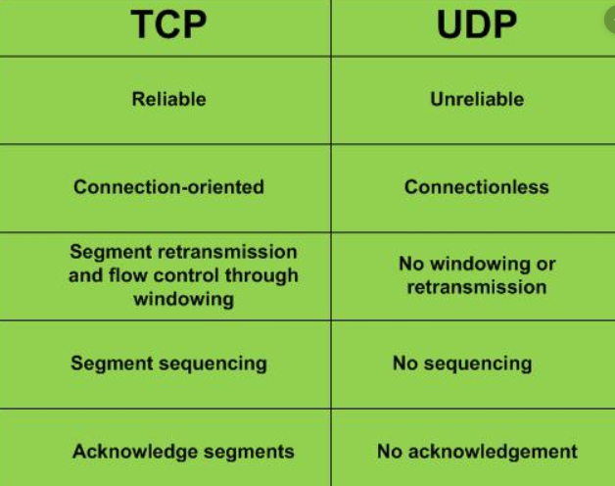
Revisiting Web Protocols
TCP- Transmission Control Protocol
UDP- User Datagram Protocol
TCP and UDP are the two most common transport protocols. TCP is used when an application requires acknowledgement of receipt.
Notes:
The term “high-level protocol” attempts to distinguish protocols designed to control the computing processes involved in an application from “low-level protocols” designed primarily to control communication processes.
Protocols exist for several different applications. Examples include wired networking (e.g., Ethernet), wireless networking (e.g., 802.11ac), and Internet communication (e.g., IP).
The Internet protocol suite, which is used for transmitting data over the Internet, contains dozens of protocols. These protocols may be broken up into four catagories:
Link layer - PPP, DSL, Wi-Fi, etc.
Internet layer - IPv4, IPv6, etc.
Transport layer - TCP, UDP, etc.
Application layer - HTTP, IMAP, FTP, etc

Slide 16
Revisiting Web Protocols
HTTP-HyperText Tansfer Protocol.
HTTPs- HyperText Transfer Protocol over Secure Socket Layer. HTTPS is used for personal or sensitive information for example in banks.
For a website to use HTTPS it needs to have an SSL certificate installed on the server. These are usually issued by a trusted 3rd party, referred to as a Certificate Authority (CA).
FTP stands for File Transfer Protocol. It is used to transfer files across the Internet. FTP is commonly used by web developers to publish updates to a website (i.e. to upload a new version of the website).
Different protocols make use of different port numbers. Eg port 80 for HTTP request

Slide 17
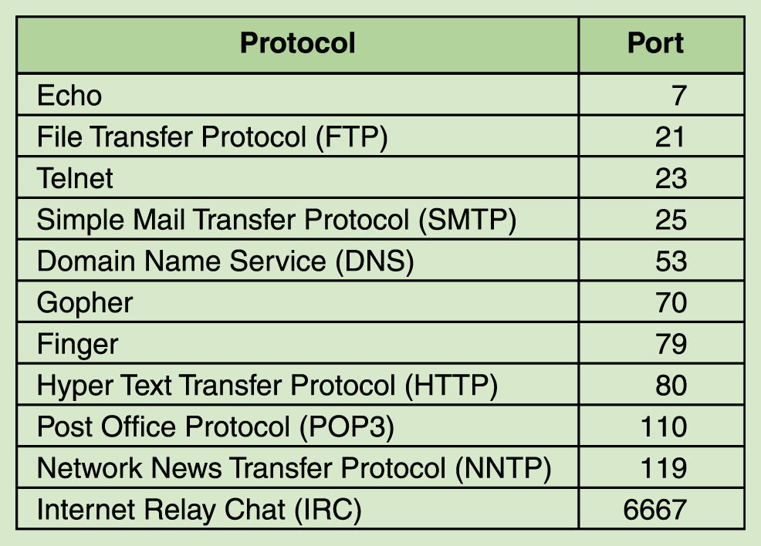
Common port Numbers

Slide 18
Web Addresses
URL stands for Uniform Resource Locator (URL) and is probably most easily described as a "web address". Here is examples of a URL:
https://www.LifeChoices.com/Conding/HTML.cfm
The URL typically points to the home page or default page (often index.html) that is located in the root folder of the website.
Lifecoices is the domain. A domain is a unique name assigned to a website. Domain names are easier to remember for users than IP addresses.
An example of IP address for www.lifechoices.co.za is
197.221.14.53
Notes:
An internet address of a website, file, or document in the general format http://www.address/directories/filename Every computer connected to the internet has its unique web address, without which it cannot be reached by other computers. Also called universal resource locator or Uniform Resource Locator (URL). Read more: http://www.businessdictionary.com/definition/web-address.html

Slide 19
Web Hosting
Web hosting is the business or activity of finding space and access for websites.
Hosting involves having your site and content placed on a server.
Why then do I need a host?
Hosting your own website requires
i)uninterrupted power supply,
ii)High tech skills,
iii) Static IP address and round clock maintenance
In order to host your page on a web server you need to pay a hosting charge
Notes:
ISPs can also provides web hosting facilities to its customers.

Slide 20
Points to consider when deciding on hosting companies
Uptime
Disk space
Bandwidth & Cap limit
Site backups
Scalability
Years in the industry
Support
Security considerations
So what are the options?

Slide 21
Web Hosting options
Shared hosting
Dedicated hosting
Virtual Private Server (VPS)
Cloud Based Web Hosting
Colocation Web Hosting
Self Service Web Hosting-
Notes:
Shared hosting- with shared costs
Dedicated hosting-one site per server
Virtual Private Server (VPS) hosting-space on many virtul servers
Cloud Based Web Hosting-lets hundreds of individual servers work together so that it looks like one giant server.
Colocation Web Hosting-you rent rack space from a data center. You bring in your own server hardware and they provide power, cooling, physical security, and an internet uplink.
Self Service Web Hosting-

Slide 22
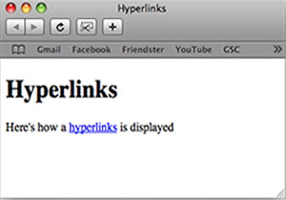
Hyperlinks
The documents within a web site are typically hyperlinked and a navigation system (or menu) permits the user to move between pages.
A simple website could be organized in just one folder, but large websites need to be organized in some manner because of the large number of files.
Types of links: relative link and Absolute link
Notes:
A relative link means that it is relative to the current document. The Web server knows the location of the current document so it knows how to find relative links.
An absolute link defines the location of the document including the protocol required to get the document, the server, the directory and the name of the document.

Slide 23
Relative and absolute Examples
Example of Relative links
<a href=“notes.html”>Notes</a>
<a href=“/biology/notes.html”>Notes</a>
Example of Absolute link
<a href=“http://www.w3.org/Consortium/mission”>
Mission statement</a>

Slide 24
Webpage Development Standards
The World Wide Web Consortium (W3C) is an international community that develops open standards.
An open standard is a standard that is publicly available and has various rights to use associated with it, and may also have various properties of how it was designed (e.g. open process)
The W3C developed the standards for HTML and CSS.
Notes:
The W3C mission is to lead the World Wide Web to its full potential by developing protocols and guidelines that ensure the long-term growth of the Web.

Slide 25
Webpage Development Standards
The HTML standards are constantly evolving to meet the needs of Web users. The current standard is HTML5.
The W3C also creates standards for website accessibility, mobile web, etc.
The W3C has a Web Accessibility Initiative (WAI) which develops strategies, guidelines, and resources to help make the Web accessible to people with disabilities.

Slide 26
Recap
Explain common terminology (web server, web page, website)
Concepts of web addressing, ISPs, DNS
High level protocols

Slide 27
Questions?
?

Slide 28
References
Reid, A & Lorenz J.Ed.(2008). Networking for Home and Small Businesses. CCNA Discovery Learning Guide. Cisco Press.

